Slide 1
Social Media and Bullying
18 hours a week spent online.
OVER SHARE OF PERSONAL INFORMATION
MORE VULNERABLE TO PERSONAL ATTACKS
THE ONLINE COHORT IS FAILING TO UNITE
Australian Bureau of Statistics

Slide 2

Welcome to Youtube
Video based social media prone to bullying.
66% of students use
21% experience abuse
Attacks are on personal features
NoBullying.com 2014

Slide 3
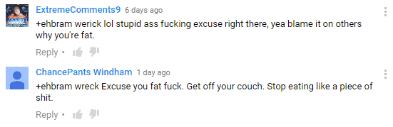

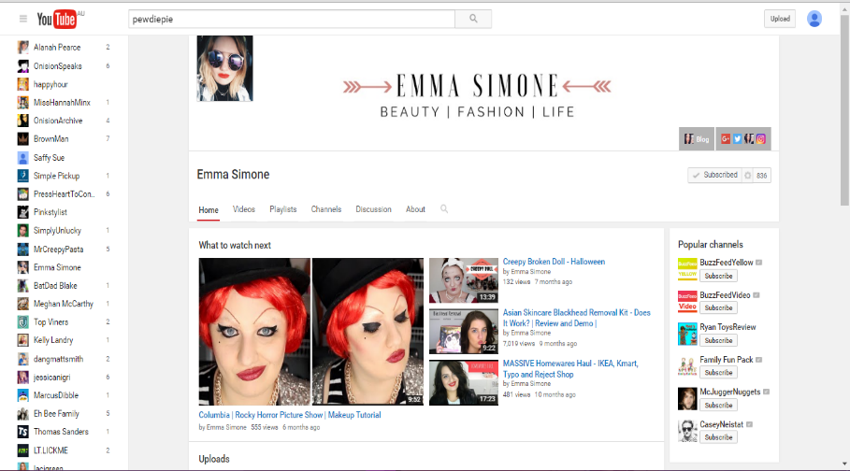
YOUTUBE FUNDAMENTALS
THE ABLITY TO PROVIDE FEED BACK
LIKE
DISLIKE
SHARE
COMMENT
SUBSCRIBE
UNSUBSCRIBE

Slide 4

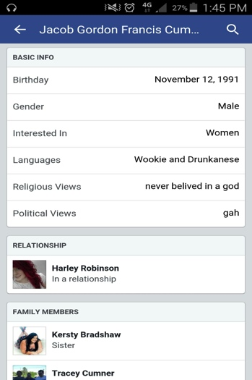

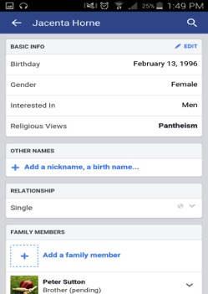
Social Media and Bullying
“Increasingly we choose in-home entertainment and the internet as our outlet” – Lily Cheung^{PhD}: Does Social Media Make Us Lonely?
100
80
60
40
20

Slide 5
Social Media: Making Us Lonely.
False reflection of self
Cyberbullying
Withdrawal of social activity
… Loneliness

